Slide 1
DATABASE SYSTEMS
FACULTY OF AI & MMG
Structured Query Language

Slide 2
MySQL
MySQL is a very popular open-source relational database management system (RDBMS).
MySQL is a relational database management system
MySQL is free & open-source
MySQL is ideal for both small and large applications
MySQL is very fast, reliable, scalable, and easy to use
MySQL was first released in 1995
MySQL is developed, distributed, and supported by Oracle Corporation
MySQL is named after co-founder Ulf Michael "Monty" Widenius's daughter: My

Slide 3
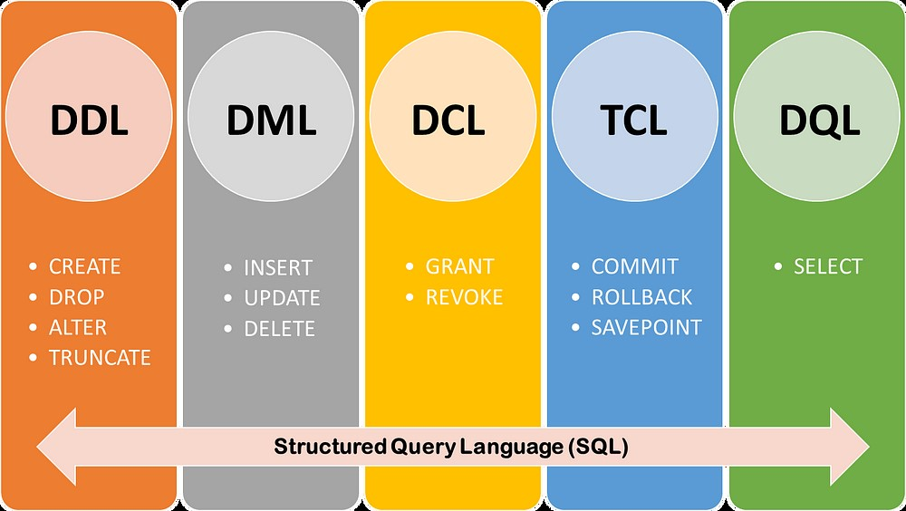

Slide 4
Overview of DDL Statements
Data Definition Language (DDL):
The CREATE statement is used to create a new database, table, index, or other database objects.
Used to define and modify database structures.
Common statements: CREATE, ALTER, DROP, TRUNCATE, RENAME, CREATE INDEX, DROP INDEX.

Slide 5
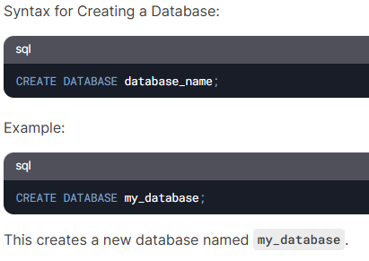
CREATE Statements
Make sure you have admin privilege before creating any database. For Checking:
Show databases;

Slide 6
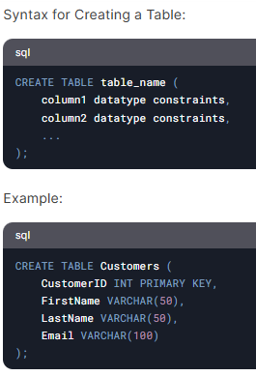
CREATE Statements
This creates a table named Customers with four columns: CustomerID, FirstName, LastName, and Email.

Slide 7
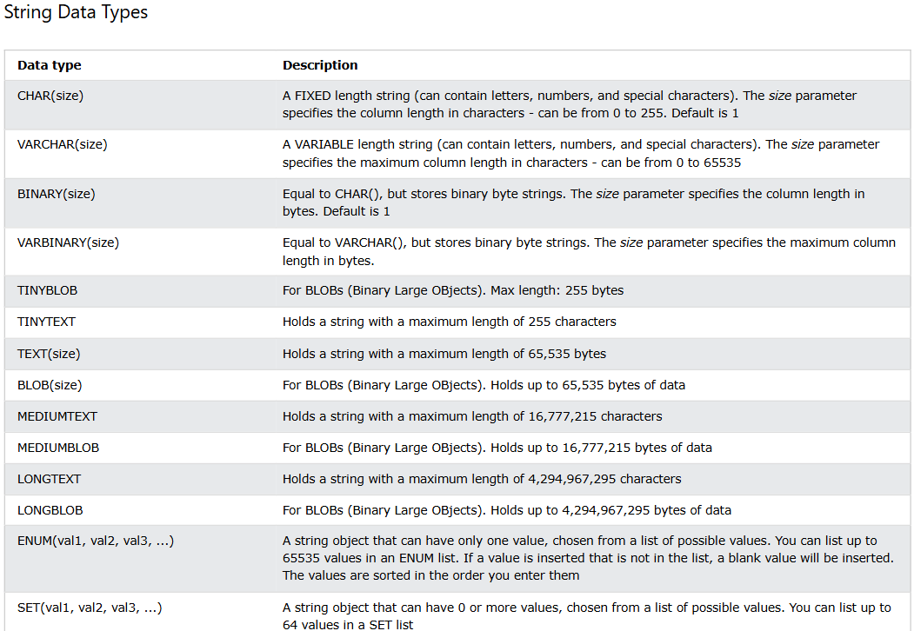
MySQL Data Types
Each column in a database table is required to have a name and a data type.
In MySQL there are three main data types: string, numeric, and date or time.

Slide 8
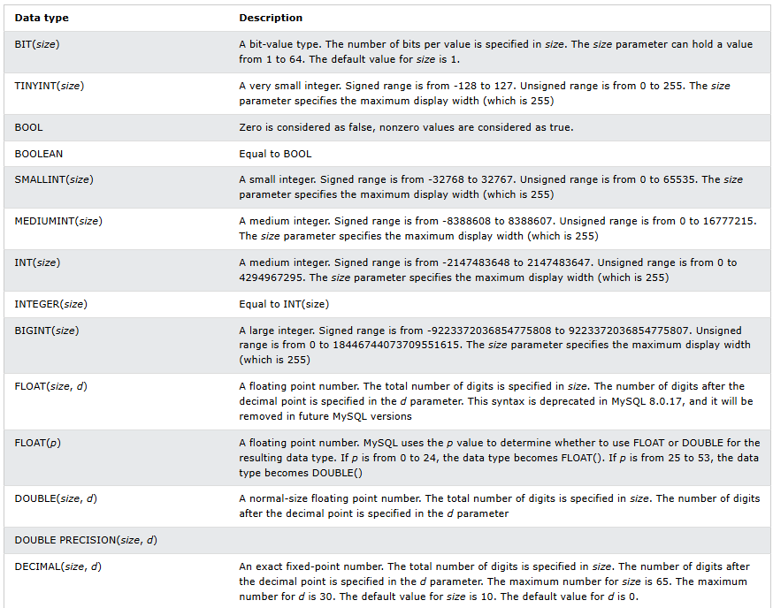
MySQL Data Types
Numeric datatypes

Slide 9
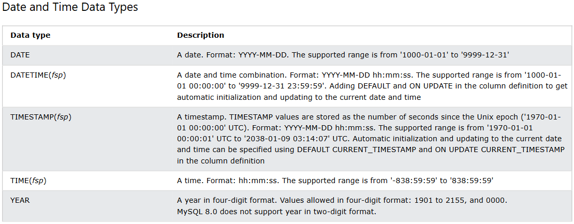
MySQL Data Types
Date and Time datatypes

Slide 10
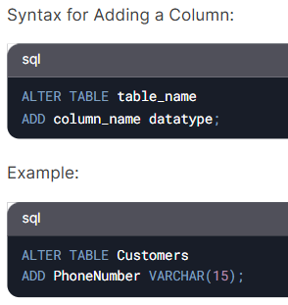
ALTER Statements
The ALTER statement is used to modify the structure of an existing table, such as adding, deleting, or modifying columns.
This adds a new column named PhoneNumber to the Customers table.

Slide 11
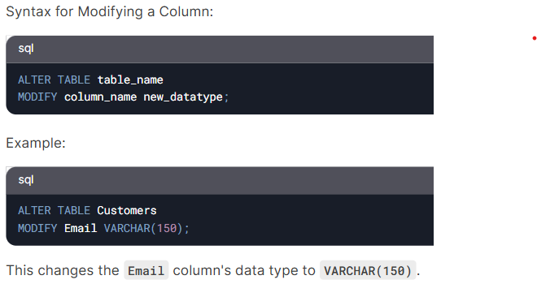
ALTER Statements

Slide 12
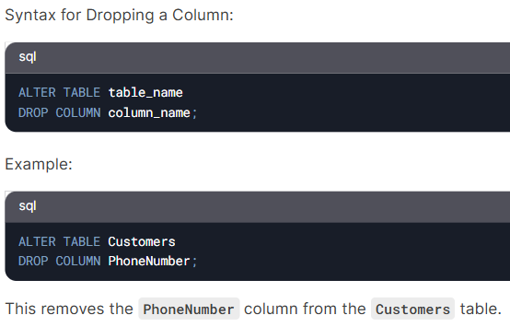
ALTER Statements

Slide 13
MySQL Constraints
SQL constraints are used to specify rules for data in a table.
Constraints can be specified when the table is created with the CREATE TABLE statement, or after the table is created with the ALTER TABLE statement.
This ensures the accuracy and reliability of the data in the table. If there is any violation between the constraint and the data action, the action is aborted.
Constraints can be column level or table level. Column level constraints apply to a column, and table level constraints apply to the whole table.

Slide 14
MySQL Constraints
The following constraints are commonly used in SQL:
NOT NULL - Ensures that a column cannot have a NULL value
UNIQUE - Ensures that all values in a column are different
PRIMARY KEY - A combination of a NOT NULL and UNIQUE. Uniquely identifies each row in a table
FOREIGN KEY - Prevents actions that would destroy links between tables
CHECK - Ensures that the values in a column satisfies a specific condition
DEFAULT - Sets a default value for a column if no value is specified
CREATE INDEX - Used to create and retrieve data from the database very quickly

Slide 15
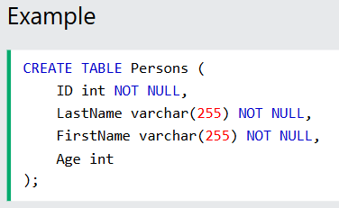
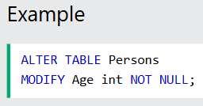
MySQL Constraints
MySQL NOT NULL Constraint
By default, a column can hold NULL values.
The NOT NULL constraint enforces a column to NOT accept NULL values.
NOT NULL on CREATE TABLE
The following SQL ensures that the "ID", "LastName", and "FirstName" columns will NOT accept NULL values when the "Persons" table is created:
NOT NULL on ALTER TABLE
To create a NOT NULL constraint on the "Age" column when the "Persons" table is already created, use the following SQL:

Slide 16
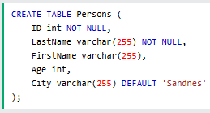
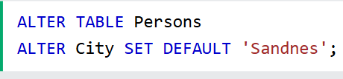
MySQL Constraints
MySQL DEFAULT Constraint
The DEFAULT constraint is used to set a default value for a column.
The default value will be added to all new records, if no other value is specified.
DEFAULT on CREATE TABLE
The following SQL sets a DEFAULT value for the "City" column when the "Persons" table is created:
DEFAULT on ALTER TABLE
To create a DEFAULT constraint on the "City" column when the table is already created, use the following SQL:
More examples…

Slide 17
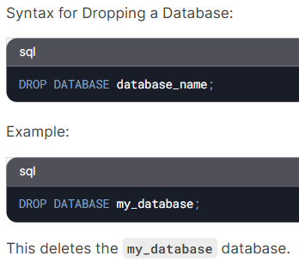
DROP
The DROP statement is used to delete an existing database, table, or index.

Slide 18
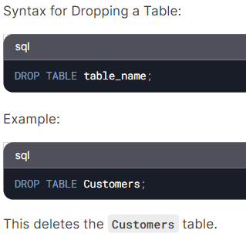
Drop Statements

Slide 19
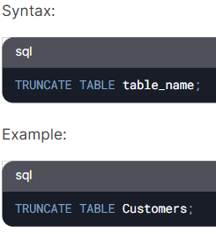
Truncate Statements
The TRUNCATE statement is used to delete all rows from a table without deleting the table itself.
This removes all rows from the Customers table but keeps the table structure intact.

Slide 20
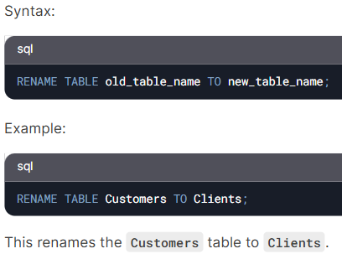
RENAME Statements
The RENAME statement is used to rename a table.

Slide 21
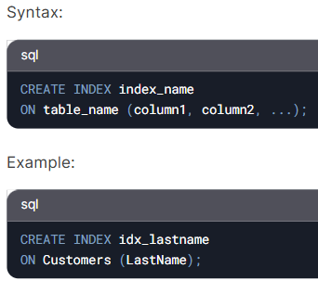
CREATE INDEX
The CREATE INDEX statement is used to create an index on one or more columns of a table, which improves query performance.
This creates an index named idx_lastname on the LastName column of the Customers table.

Slide 22
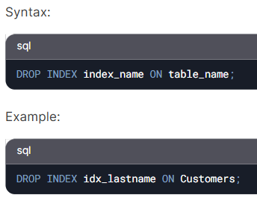
DROP INDEX
The DROP INDEX statement is used to delete an index.
This deletes the idx_lastname index from the Customers table.

Slide 23
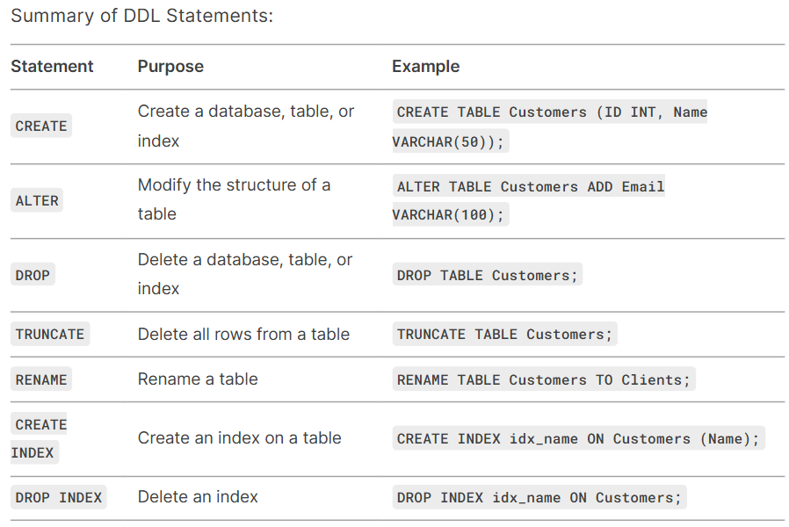

Slide 24
Data QUEYRY language (DQl)
select

Slide 25
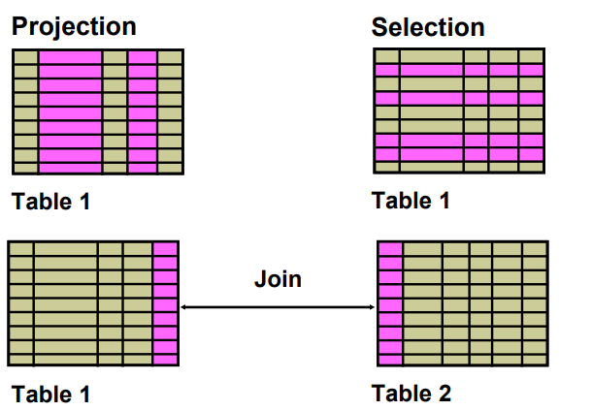
Capabilities of SELECT Statements

Slide 26
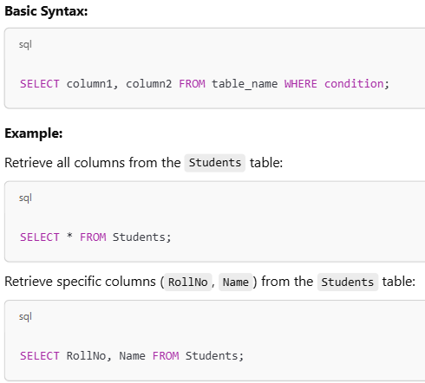
Data Query Language (DQL)
DQL (Data Query Language) in MySQL is used to retrieve data from the database.
The main DQL command in SQL is SELECT, which is used to fetch data from tables based on conditions.

Slide 27
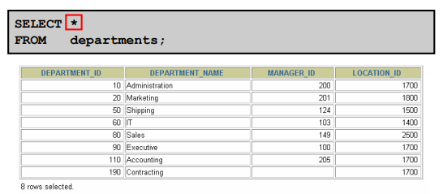
Selecting All Columns

Slide 28
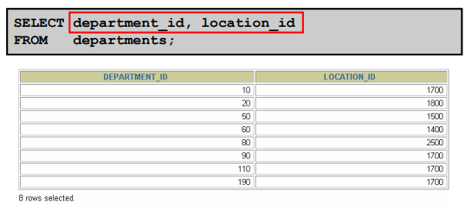
Selecting Specific Columns

Slide 29
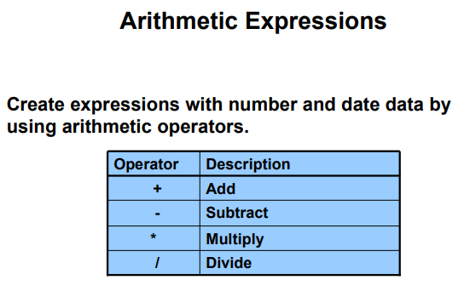
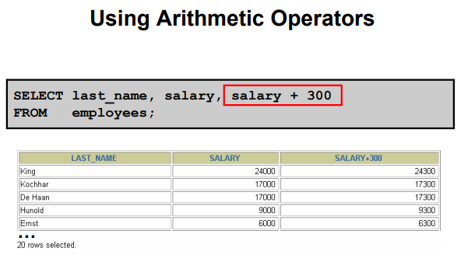

Slide 30

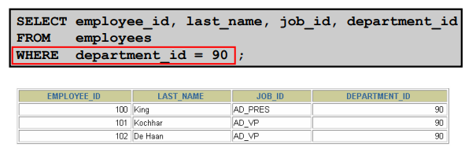
WHERE Clause
The WHERE clause is used to filter records.
Note: The WHERE clause is not only used in SELECT statements, it is also used in UPDATE, DELETE, etc.!
Syntax:

Slide 31
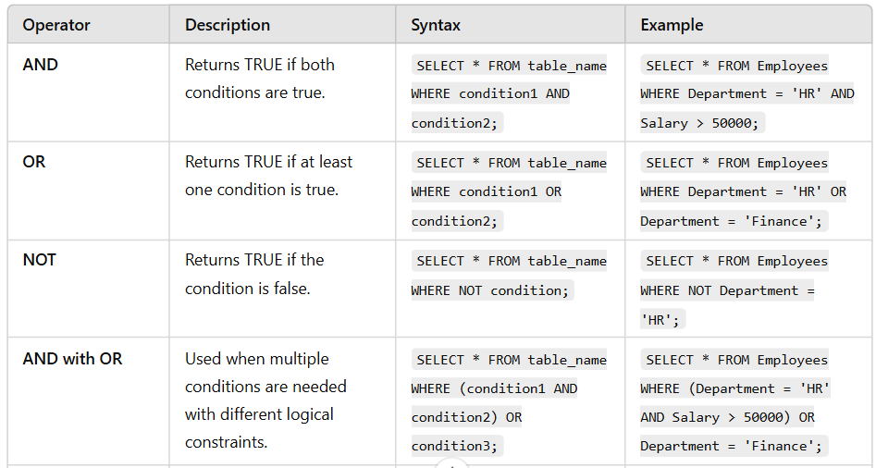
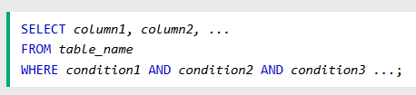
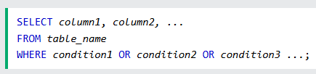
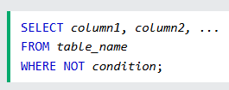
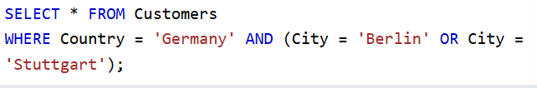
AND, OR and NOT Operators
The WHERE clause can be combined with AND, OR, and NOT operators.

Slide 32
Command | Description | Syntax | Example
SELECT | Retrieves data from one or more tables. | SELECT column1, column2 FROM table_name; | SELECT Name, Age FROM Students;
WHERE | Filters records based on a condition. | SELECT column1 FROM table_name WHERE condition; | SELECT * FROM Students WHERE Age > 20;
ORDER BY | Sorts results in ascending or descending order. | SELECT column1 FROM table_name ORDER BY column1 [ASC DESC]; | SELECT Name FROM Students ORDER BY Age DESC;
GROUP BY | Groups records based on a column. | SELECT column1, COUNT(*) FROM table_name GROUP BY column1; | SELECT Department, COUNT(*) FROM Students GROUP BY Department;
HAVING | Filters grouped records. | SELECT column1, COUNT(*) FROM table_name GROUP BY column1 HAVING condition; | SELECT Department, COUNT(*) FROM Students GROUP BY Department HAVING COUNT(*) > 5;
LIMIT | Limits the number of rows returned. | SELECT column1 FROM table_name LIMIT number; | SELECT * FROM Students LIMIT 5;
DISTINCT | Removes duplicate values. | SELECT DISTINCT column1 FROM table_name; | SELECT DISTINCT Department FROM Students;
JOIN | Combines data from multiple tables. | SELECT column1 FROM table1 JOIN table2 ON table1.col = table2.col; | SELECT Students.Name, Courses.CourseName FROM Students INNER JOIN Courses ON Students.RollNo = Courses.RollNo;

Slide 33

Tasks 1
Write 3 MySQL statements each of the following:
SELECT
WHERE
ORDER BY
GROUP BY
HAVING
LIMIT
DISTINCT
JOIN

Slide 34
Data Manipulation language (DML)
Insert
Update
delete

Slide 35


INSERT INTO Statement
The INSERT INTO statement is used to insert new records in a table.
INSERT INTO Syntax
It is possible to write the INSERT INTO statement in two ways:
1. Specify both the column names and the values to be inserted:

Slide 36
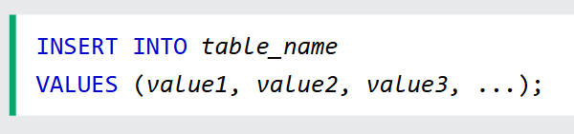
INSERT INTO Statement
2. If you are adding values for all the columns of the table, you do not need to specify the column names in the SQL query. However, make sure the order of the values is in the same order as the columns in the table.
Note: A NULL value is different from a zero value or a field that contains spaces. A field with a NULL value is one that has been left blank during record creation!

Slide 37
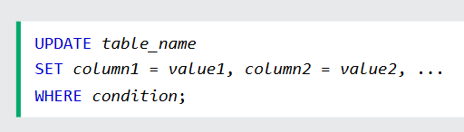
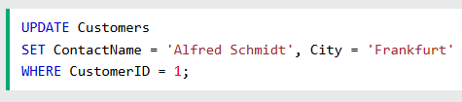

UPDATE Statement
The UPDATE statement is used to modify the existing records in a table.
Note:
when updating records in a table! Notice the WHERE clause in the UPDATE statement.
The WHERE clause specifies which record(s) that should be updated.
If you omit the WHERE clause, all records in the table will be updated!

Slide 38



DELETE Statement
The DELETE statement is used to delete existing records in a table.
Note:
while deleting records in a table! Notice the WHERE clause in the DELETE statement.
The WHERE clause specifies which record(s) should be deleted.
If you omit the WHERE clause, all records in the table will be deleted!

Slide 39
Data CONTROL language (Dcl)
grant
revoke

Slide 40



Data Control Language (DCL)
DCL is used to control access to the data in a database. It includes commands that grant or revoke user permissions.
GRANT – Provides specific privileges to users.
REVOKE – Removes specific privileges from users.
Syntax:
Example:

Slide 41


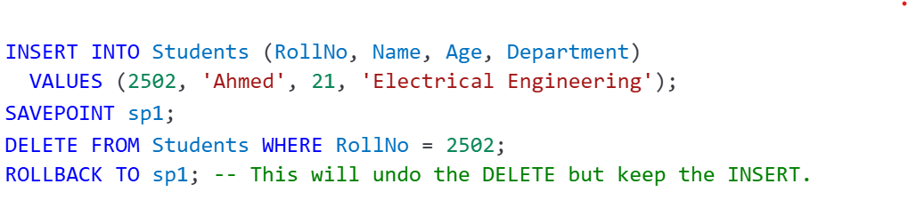
Transaction Control Language (TCL)
TCL is used to manage database transactions of the data.
COMMIT – Saves all changes made in the current transaction.
ROLLBACK – Undoes all changes in the current transaction.
SAVEPOINT – Sets a save point within a transaction to which you can later roll back.

